Slide 1

Chapter 6. Point Estimation
Weiqi Luo (骆伟祺)
School of Data & Computer Science
Sun Yat-Sen University
Email：luoweiqi@mail.sysu.edu.cn

Slide 2
Chapter 6: Point Estimation
6.1. Some General Concepts of Point Estimation
6.2. Methods of Point Estimation

Slide 3

6.1 Some General Concepts of Point Estimation
In ordert to get some population characteristics, statistical inference needs obtain sample data from the population under study, and achieve the conclusions can then be based on the computed values of various sample quantities (statistics).
Typically, we will use the Greek letter θ for the parameter of interest. The objective of point estimation is to select a single number, based on sample data (statistic ), that represents a sensible value for θ.

Slide 4
6.1 Some General Concepts of Point Estimation
Point Estimation
A point estimate of a parameter θ is a single number that can be regarded as a sensible value for θ.
A point estimate is obtained by selecting a suitable statistic and computing its value from the given sample data. The selected statistic is called the point estimator of θ.
Here, the type of population
under study is usually known,
while the paprameters are unkown.
A function
(statistic )
Population
Q #1: How to get the candiate estimators
based on the population?
A Sample
A quantity
Parameters θ
Q #2: How to measure the candidate
estimators?
Estimating

Slide 5
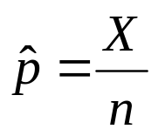
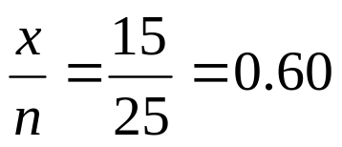
6.1 Some General Concepts of Point Estimation
Example 6.1
The manufacturer has used this bumper in a sequence of 25 controlled crashes against a wall, each at 10 mph, using one of its compact car models. Let X = the number of crashes that result in no visible damage to the automobile. What is a sensible estimate of the parameter p = the proportion of all such crashes that result in no damage
If X is observed to be x = 15, the most reasonable estimator and estimate are
estimator
estimate =

Slide 6
6.1 Some General Concepts of Point Estimation
Example 6.2
Reconsider the accompanying 20 observations on dielectric breakdown voltage for pieces of epoxy resin first introduced in Example 4.29 (pp. 193)
The pattern in the normal probability plot given there is quite straight, so we now assume that the distribution of breakdown voltage is normal with mean value μ. Because normal distribution are symmetric, μ is also the median lifetime of the distribution. The given observation are then assumed to be the result of a random sample X₁, X₂, …, X₂₀ from this normal distribution.
24.46 | 25.61 | 26.25 | 26.42 | 26.66 | 27.15 | 27.31 | 27.54 | 27.74 | 27.94
27.98 | 28.04 | 28.28 | 28.49 | 28.50 | 28.87 | 29.11 | 29.13 | 29.50 | 30.88

Slide 7

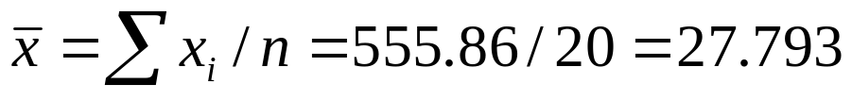


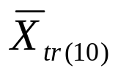
6.1 Some General Concepts of Point Estimation
Example 6.2 (Cont’)
Consider the following estimators and resulting estimates for μ
a. Estimator= , estimate=
b. Estimator= , estimate=
c. Estimator [ min(X_{i}) + max(X_{j})]/2 = the average of the two extreme lifetimes, estimate=[ min(x_{i})+max(x_{i})]/2 = (24.46+30.88)/2 = 27.670
d. Estimator = , the 10% trimmed mean (discard the smallest and largest 10% of the sample and then average)

Slide 8
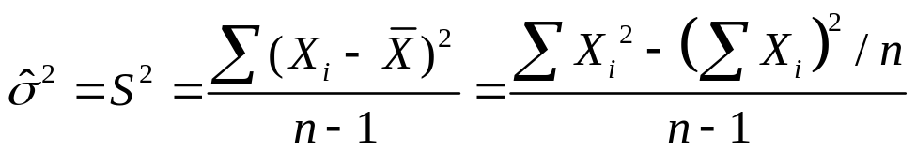
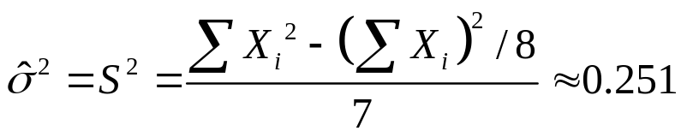
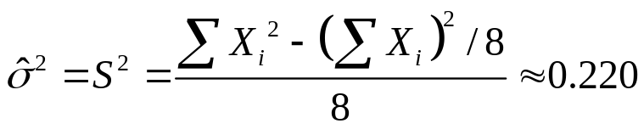
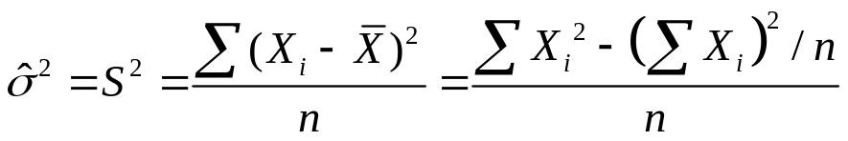
6.1 Some General Concepts of Point Estimation
Example 6.3
In the near future there will be increasing interest in developing low-cost Mg-based alloys for various casting processes. It is therefore important to have practical ways of determining various mechanical properties of such alloys. Assume that the observations of a random sample X₁, X₂, …, X₈ from the population distribution of elastic modulus under such circumstances. We want to estimate the population variance σ²
Method #1: sample variance
Method #2: Divided by n rather than n-1

Slide 9
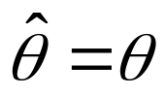
6.1 Some General Concepts of Point Estimation
Estimation Error Analysis
Note that is a function of the sample X_{i}’s, so it is a random variable.
Therefore, an accurate estimator would be one resulting in small estimation errors, so that estimated values will be near the true value θ (unkown).
A good estimator should have the two properties:
1. unbiasedness (i.e. the average error should be zero)
2. minimum variance (i.e. the variance of error should be samll)
+ error of estimation

Slide 10


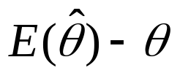



6.1 Some General Concepts of Point Estimation
Unbiased Estimator
A point estimator is said to be an unbiased estimator of θ if
for every possible value of θ.
If is not unbiased, the difference is called the bias of
pdf of
pdf of
Note: “centered” here means the expected
vaule, not the median, of the the distribution
of is equal to θ
θ
Bias of θ₁

Slide 11

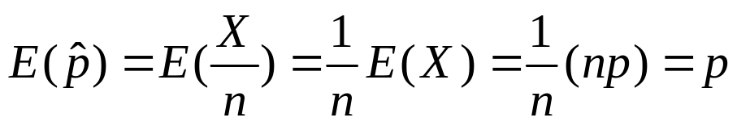
6.1 Some General Concepts of Point Estimation
Proposition
When X is a binomial rv with parameters n and p, the sample proportion =X/n is an unbiased estimator of p.
Refer to Example 6.1, the sample proportion X/n was used as an estimator of p, where X, the number of sample successes, had a binomial distribution with parameters n and p, thus

Slide 12
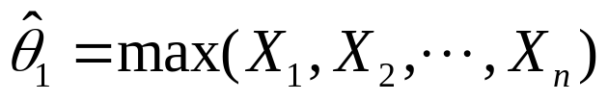
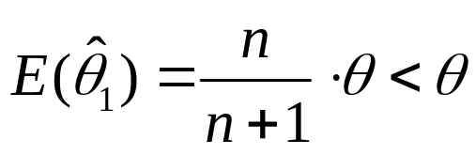
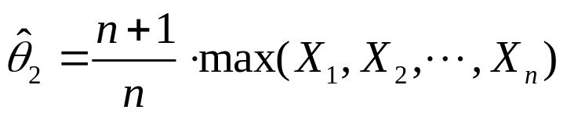
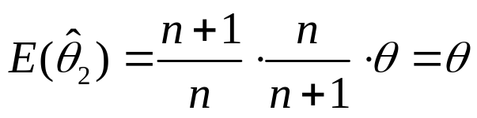
6.1 Some General Concepts of Point Estimation
Example 6.4
Suppose that X, the reaction time to a certain stimulus, has a uniform distribution on the interval from 0 to an unknown upper limit θ. It is desired to estimate θ on the basis of a random sample X₁, X₂, …, X_{n} of reaction times. Since θ is the largest possible time in the entire population of reaction times, consider as a first estimator the largest sample reaction time:
Since (refer to Ex. 32 in pp. 279 )
Another estimator
biased estimator, why?
unbiased estimator

Slide 13
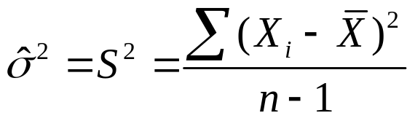

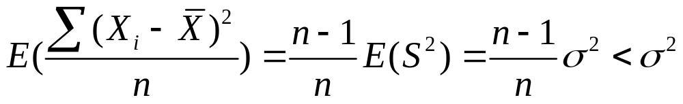
6.1 Some General Concepts of Point Estimation
Proposition
Let X₁, X ₂, …, X_{n} be a random sample from a distribution with mean μ and variance σ². Then the estimator
is an unbiased estimator of σ² , namely
Refer to pp. ? for the proof.
However,

Slide 14


6.1 Some General Concepts of Point Estimation
Proposition
If X₁, X₂,…X_{n} is a random sample from a distribution with mean μ, then is an unbiased estimator of μ. If in addition the distribution is continuous and symmetric, then and any trimmed mean are also unbiased estimator of μ
Refer to the estimators in Example 6.2

Slide 15


6.1 Some General Concepts of Point Estimation
Estimators with Minimum Variance
pdf of , an unbiased estimator
pdf of , another unbiased estimator
θ
Obivously, the estimator is better than the in this example

Slide 16
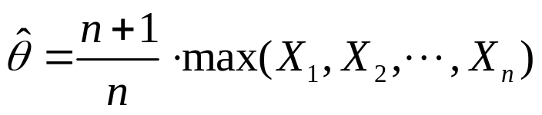
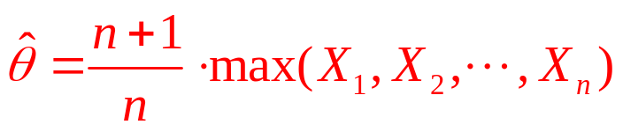
6.1 Some General Concepts of Point Estimation
Example 6.5 (Ex. 6.4 Cont’)
When X₁, X₂, … X_{n} is a random sample from a uniform distribution on [0, θ], the estimator
is unbiased for θ
It is also shown that is the MVUE of θ.

Slide 17
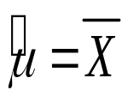
6.1 Some General Concepts of Point Estimation
Theorem
Let X₁, X₂, …, X_{n} be a random sample from a normal distribution with parameters μ and δ. Then the estimator is the MVUE for μ.
How about those un-normal distributions?

Slide 18
6.1 Some General Concepts of Point Estimation
Estimator Selection
When choosing among several different estimators of θ, select one that is unbiased.
Among all estimators of θ that are unbiased, choose the one that has minimum variance. The resulting is called the minimum variance unbiased estimator (MVUE) of θ.
pdf of , a biased estimator
pdf of , the MVUE
In some cases, a biased estimator
is perferable to the MVUE
θ

Slide 19
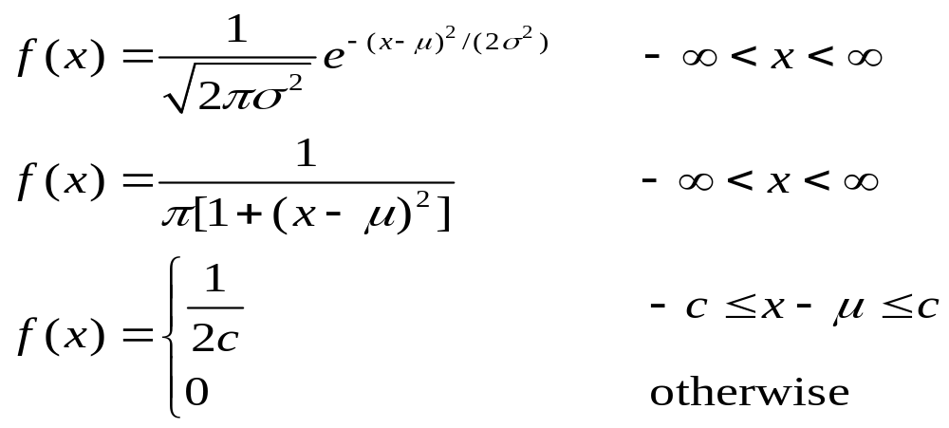
6.1 Some General Concepts of Point Estimation
Example 6.6
Suppose we wish to estimate the thermal conductivity μ of a certain material. We will obtain a random sample X₁, X ₂, …, X_{n} of n thermal conductivity measurements. Let’s assume that the population distribution is a member of one of the following three families:
Gaussian Distribution
Cauchy Distribution
Uniform Distribution

Slide 20




6.1 Some General Concepts of Point Estimation
1. If the random sample comes from a normal distribution, then is the best of the four estimators, since it is the MVUE.
2. If the random sample comes from a Cauchy distribution, then and (the average of the two extreme observations) are terrible estimators for μ, whereas is quite good; is bad because it is very sensitive to outlying observations, and the heavy tails of the Cauchy distribution make a few such observation likely to appear in any sample.
3. If the underlying distribution is uniform, the best estimator is ; this estimator is greatly influenced by outlying observations, but the lack of tails makes such observations impossible.
4. The trimmed mean is best in none of these three situations, but works reasonably well in all three. That is, does not suffer too much in any of the three situations.
A Robust estimator

Slide 21

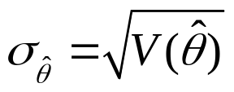



6.1 Some General Concepts of Point Estimation
The Standard Error
The standard error of an estimator is its standard deviation .
If the standard error itself involves unknown parameters whose values can be estimated, substitution of these estimates into yields the estimated standard error (estimated standard deviation) of the estimator. The estimated standard error can be denoted either by or by .

Slide 22

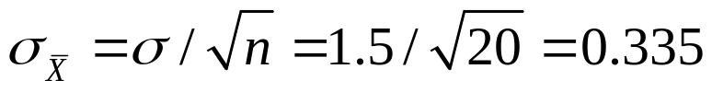


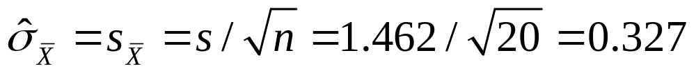
6.1 Some General Concepts of Point Estimation
Example 6.8
Assuming that breakdown voltage is normally distributed,
is the best estimator of μ. If the value of σ is known to be 1.5, the standard error of is
If, as is usually the case, the value of σ is unknown, the estimate is substituted into to obtain the estimated standard error

Slide 23
6.1 Some General Concepts of Point Estimation
Homework
Ex. 1, Ex. 8, Ex. 9, Ex. 13

Slide 24
6.2 Methods of Point Estimation
Two “constructive” methods for obtaining point estimators
Method of Moments
Maximum Likehood Estimation

Slide 25
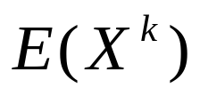
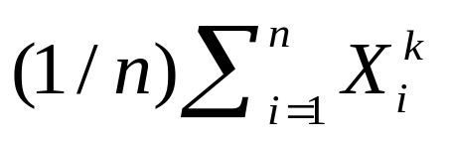
6.2 Methods of Point Estimation
Moments
Let X₁, X₂,…, X_{n} be a random sample from a pmf or pdf f(x). For k = 1, 2, 3, …, the kth population moment, or kth moment of the distribution f(x), is . The kth sample moment is .

Slide 26
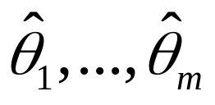
6.2 Methods of Point Estimation
Moment Estimator
Let X₁, X₂, …, X_{n} be a random sample from a distribution with pmf or pdf f(x;θ₁,…,θ_{m}), where θ₁,…,θ_{m} are parameters whose values are unknown. Then the moment estimators are obtained by equating the first m sample moments to the corresponding first m population moments and solving for θ₁,…,θ_{m} .
n is large
With the given
sample x_{i}
With unkonwn θ_{i}
K-th sample moment
K-th population moment

Slide 27
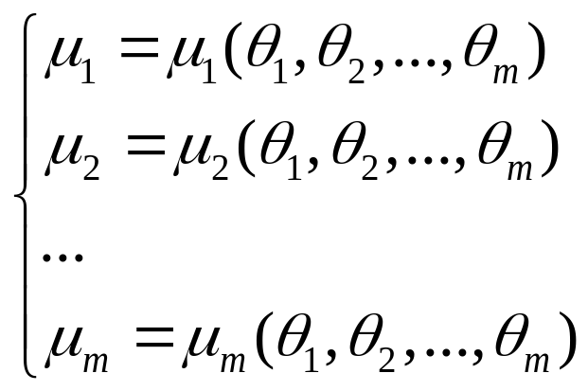
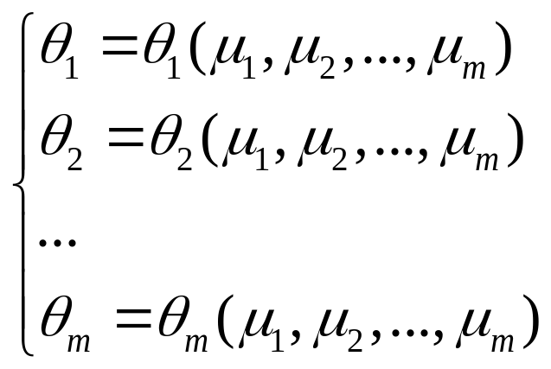
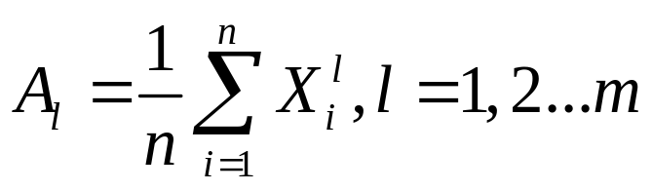
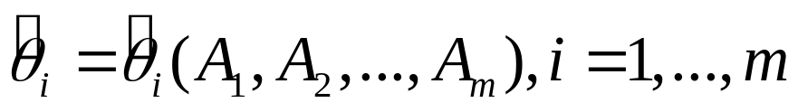
6.2 Methods of Point Estimation
General Algorithm :
The first m population moments
The solution of equations
Use the first m sample moment
to represent the population moments μ_{l}

Slide 28
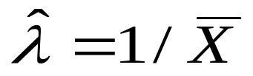
6.2 Methods of Point Estimation
Example 6.12
Let X₁, X₂, …, X_{n} represent a random sample of service times of n customers at a certain facility, where the underlying distribution is assumed exponential with parameter λ. How to estimate λ by using the method of moments?
Step #1: The 1st population moment E(X) = 1/λ
then we have λ = 1/ E(X)
Step #2: Use the 1st sample moment to represent 1st poulation moment E(X), and get the estimator

Slide 29
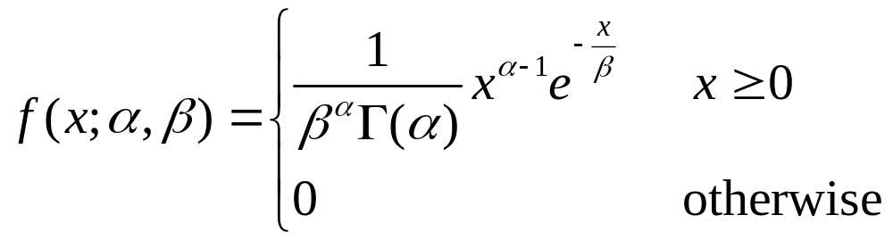
6.2 Methods of Point Estimation
Example 6.13
Let X₁, …, X_{n} be a random sample from a gamma distribution with parameters α and β. Its pdf is
There are two parameter need to be estimated, thus, consider the first two monents

Slide 30

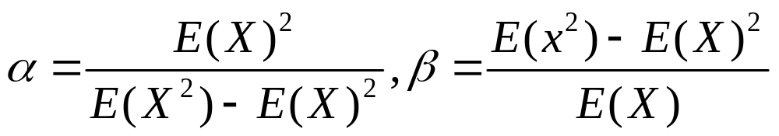
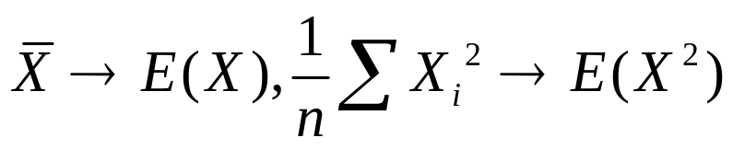
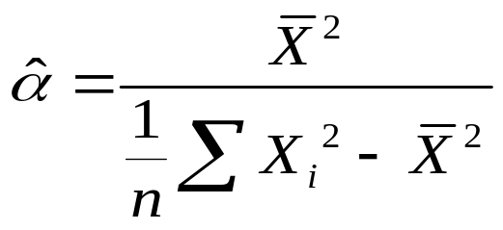
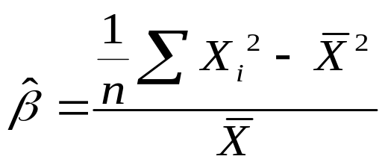
6.2 Methods of Point Estimation
Example 6.12 (Cont’)
Step #1:
Step #2:

Slide 31
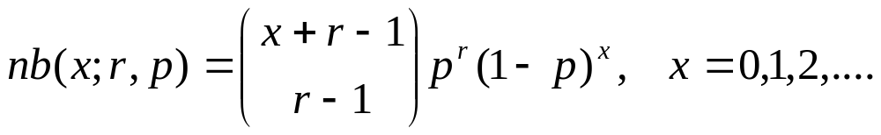
6.2 Methods of Point Estimation
Example 6.14
Let X₁, …, X_{n} be a random sample from a generalized negative binomial distribution with parameters r and p. Its pmf is
Determine the moment estimators of parameters r and p.
Note: There are two parameters needs to estimate, thus the first two moments are considered.

Slide 32

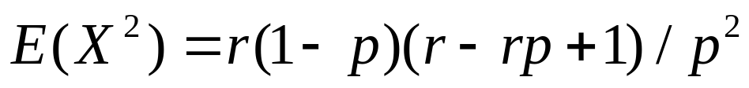
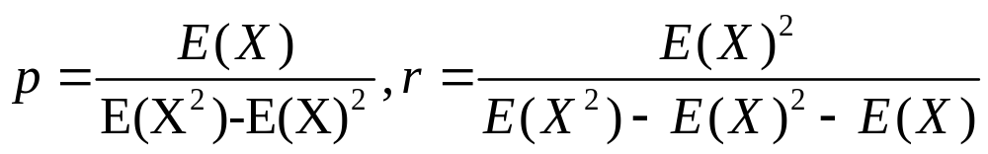
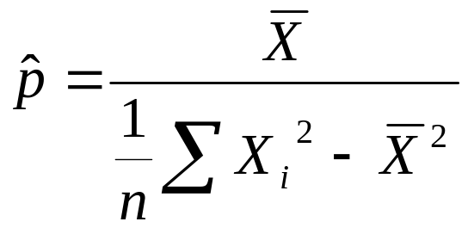
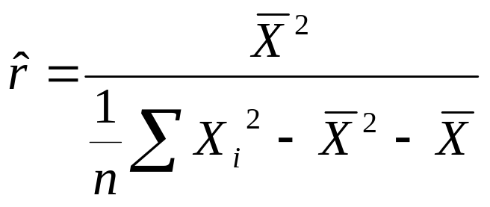
6.2 Methods of Point Estimation
Example 6.13 (Cont’)
Step #1:
Step #2:

Slide 33
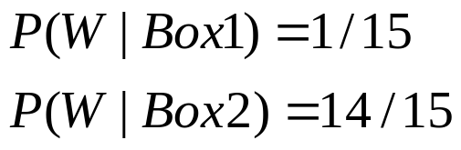
6.2 Methods of Point Estimation
Maximum Likelihood Estimation (Basic Idea)
Experiment:
We firstly randomly choose a box,
And then randomly choose a ball.
Q: If we get a white ball, which box
has the Maximum Likelihood being chosen?
Box 1
Box 2

Slide 34

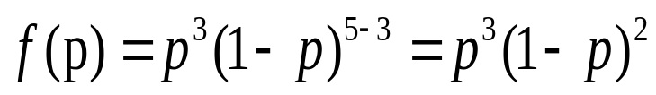




6.2 Methods of Point Estimation
Maximum Likelihood Estimation (Basic Idea)
Q: What is the probability p of hitting the target?
…
The best one among the four options

Slide 35
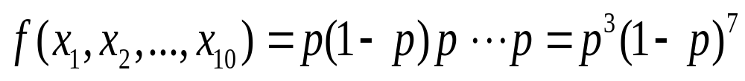
6.2 Methods of Point Estimation
Example 6.15
A sample of ten new bike helmets manufactured by a certain company is obtained. Upon testing, it is found that the first, third, and tenth helmets are flawed, whereas the others are not. Let p = P(flawed helmet) and define X₁, …, X₁₀ by X_{i} = 1 if the ith helmet is flawed and zero otherwise. Then the observed x_{i}’s are 1,0,1,0,0,0,0,0,0,1.
The Joint pmf of the sample is
For what value of p is the observed sample most likely to have occurred? Or, equivalently, what value of the parameter p should be taken so that the joint pmf of the sample is maximized?

Slide 36
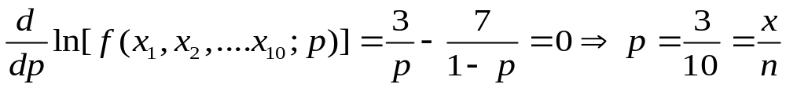

6.2 Methods of Point Estimation
Example 6.15 (Cont’)
Equating the derivative of the logarithm of the pmf to zero gives the maximizing value (why?)
where x is the observed number of successes (flawed helmets). The estimate of p is now . It is called the maximum likelihood estimate because for fixed x₁,…, x₁₀, it is the parameter value that maximizes the likelihood of the observed sample.

Slide 37
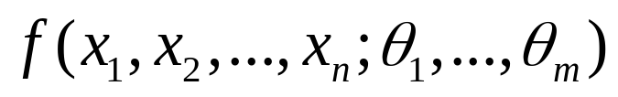
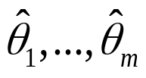
6.2 Methods of Point Estimation
Maximum Likelihood Estimation
Let X₁, X ₂, …, X_{n} have joint pmf or pdf
where the parameters θ₁, …, θ_{m} have unknown values. When x₁, …, x_{n} are the observed sample values and f is regarded as a function of θ₁, …, θ_{m}, it is called the likelihood function.
The maximum likelihood estimates(mle’s) are those values of the θ_{i}’s that maximize the likelihood function, so that
When the X_{i}’s are substituted in place of the x_{i}’s, the maximum likelihood estimators result.
for all θ₁, …, θ_{m}

Slide 38
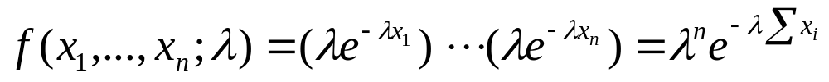
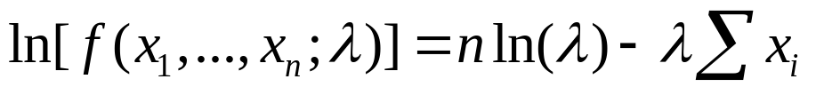



6.2 Methods of Point Estimation
Example 6.16
Suppose X₁, X₂, …, X_{n} is a random sample from an exponential distribution with the unknown parameter λ. Determine the maximum likelihood estimator of λ.
The joint pdf is (independence)
The ln(likelihood) is
Equating to zero the derivative w.r.t. λ:
The estimator

Slide 39


6.2 Methods of Point Estimation
Example 6.17
Let X₁, X ₂, …, X_{n} is a random sample from a normal distribution N(μ,δ²). Determine the maximum likelihood estimator of μ and δ² .
The joint pdf is
Equating to 0 the partial derivatives w.r.t. μ and σ², finally we have
Here the mle of δ² is not
the unbiased estimator.

Slide 40



6.2 Methods of Point Estimation
Three steps
Write the joint pmf/pdf (i.e. Likelihood function)
Get the ln(likelihood) (if necessary)
Take the partial derivative of ln(f) with respect to θ_{i}, equal them to 0, and solve the resulting m equations.

Slide 41


6.2 Methods of Point Estimation
Estimating Function of Parameters
The Invariance Principle
Let be the mle’s of the parameters θ₁, …, θ_{m}. Then the mle of any function h(θ₁,…,θ_{m}) of these parameters is the function of the mle’s.

Slide 42




6.2 Methods of Point Estimation
Example 6.20 (Ex.6.17 Cont’)
In the normal case, the mle’s of μ and σ² are and
To obtain the mle of the function
substitute the mle’s into the function

Slide 43


6.2 Methods of Point Estimation
Large Sample Behavior of the MLE
Under very general conditions on the joint distribution of the sample, when the sample size n is large, the maximum likelihood estimator of any parameter θ is approximately unbiased and has variance that is nearly as small as can be achieved by any estimator. Stated another way, the mle is approximately the MVUE of θ.
Maximum likelihood estimators are generally preferable to moment estimators because of the above efficiency properties.
However, the mle’s often require significantly more computation than do moment estimators. Also, they require that the underlying distribution be specified.

Slide 44

6.2 Methods of Point Estimation
Example 6.22
Suppose my waiting time for a bus is uniformly distributed on [0,θ] and the results x₁, …, x_{n} of a random sample from this distribution have been observed. Since f(x;θ) = 1/θ for 0 ≤ x ≤ θ and 0 otherwise,
As long as max(x_{i}) ≤ θ, the likelihood is 1/θ^{n} , which is positive, but as soon as θ <max(x_{i}), the likelihood drops to 0.
Calculus will not work because the maximum of the likelihood occurs at a point of discontinuity.

Slide 45



6.2 Methods of Point Estimation
Example 6.22 (Cont’)
the maximum
of the likelihood
Likelihood
max(x_{i})
θ
the figure shows that . Thus, if my waiting times are 2.3, 3.7, 1.5, 0.4, and 3.2, then the mle is .

Slide 46
6.2 Methods of Point Estimation
Homework
Ex. 20, Ex. 21, Ex. 28, Ex. 29

